Slide 1


Take Action on Climate Change
Climate change is a pressing global issue.
by codecrushers

Slide 2

Why Address Climate Change Now?
1
Educate
Understand the crisis.
2
Challenges
Highlight environmental issues.
3
Urgency
CO2, deforestation, human impact.

Slide 3
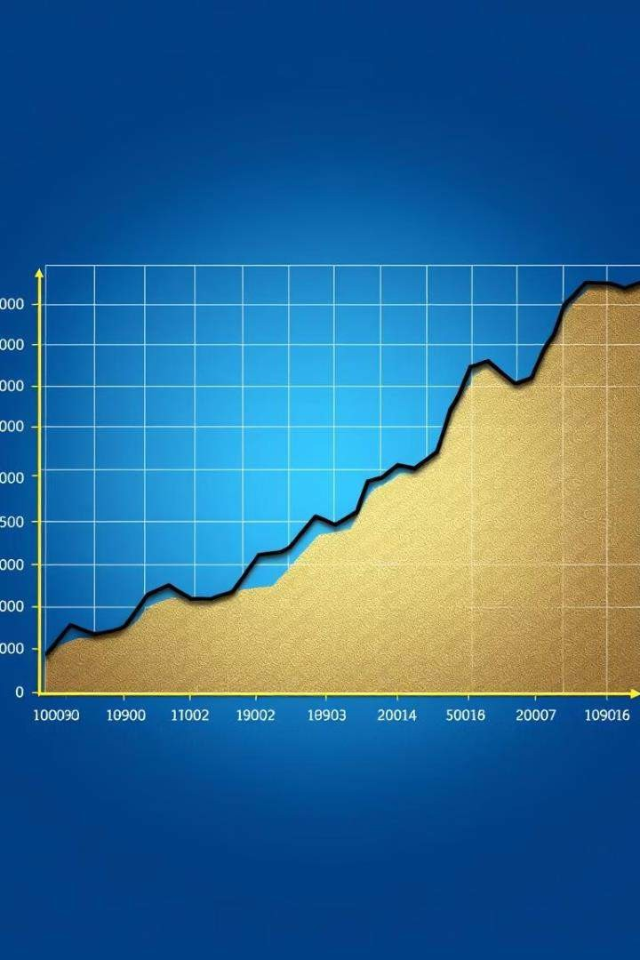
Alarming Climate Statistics
CO2 Levels 416 ppm
Global Temperature Rise 1.2°C since 1880
Forest Loss 13 million hectares/year

Slide 4

Key Solutions to Combat Climate Change
Renewable Energy
Solar, wind, geothermal power.
Sustainable Agriculture
Regenerative farming, less meat.
Green Cities
Public transport, efficient buildings.
Reforestation
Planting trees, restoring forests.

Slide 5
Engaging Tools for Climate Action
CO2 Emission Calculator
Track your carbon footprint.
Interactive Climate Map
Explore climate data by region.

Slide 6

Aligning with Global Goals
1
SDGs
Supports UN’s Sustainable Development Goals.
2
Poverty Eradication
Focus on sustainability and development.

Slide 7
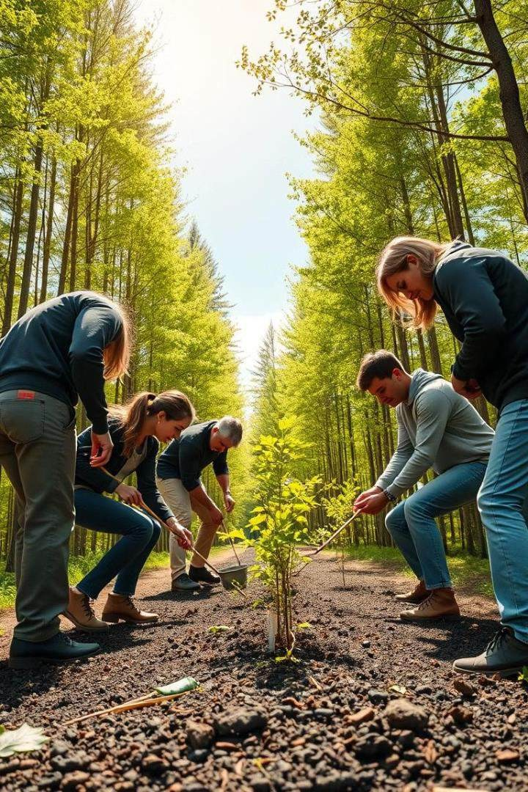



Ways to Take Action
Volunteering
Tree planting, beach cleanups.
Donating
Support climate-focused NGOs.
Raising Awareness
Encourage sustainable living.

Slide 8
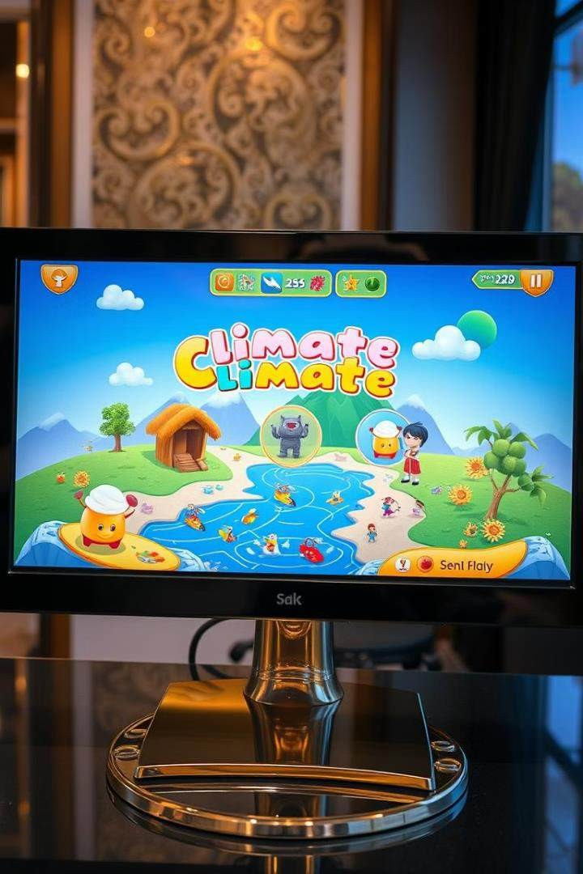
Learn and Take Action Through Games
1
Climate Games
Two interactive climate games.
2
Engaging Users
Educate on climate issues.

Slide 9
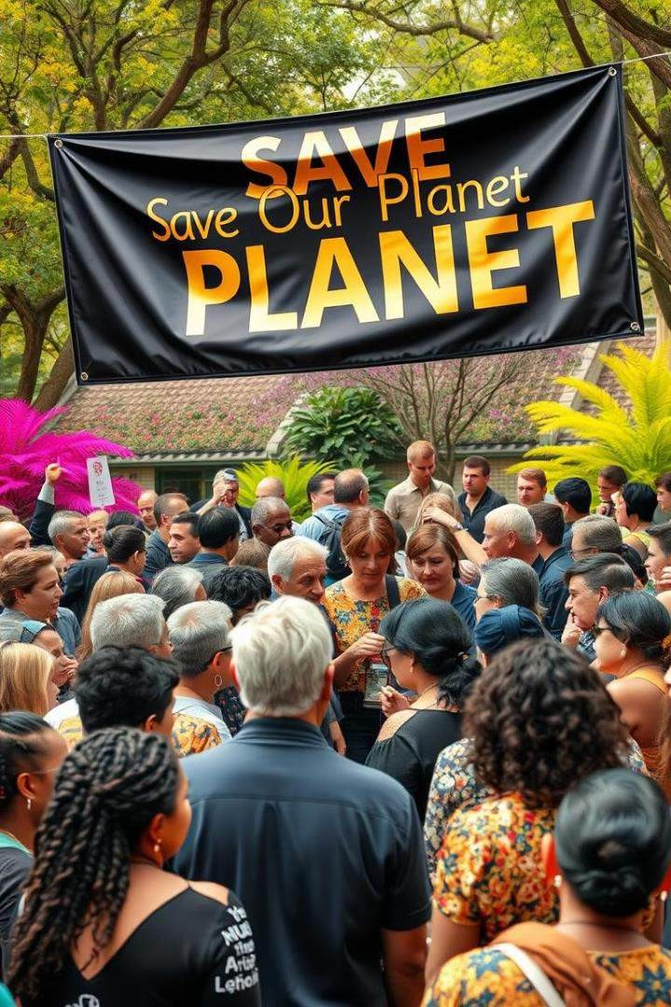
Get Involved
1
Stay Informed
Check weather and climate updates.
2
Engage
Provide feedback, join projects.

Slide 10

The Time to Act is Now
1
Global Movement
Join the climate change effort.
2
Sustainable Future
Education, tools, and action.

